Slide 1

The Forbidden Structure Method in Graph Metric Sparsification
Greg Bodwin
University of Michigan
Frontiers of Graph Algorithms
IISC, Bangalore

Slide 2
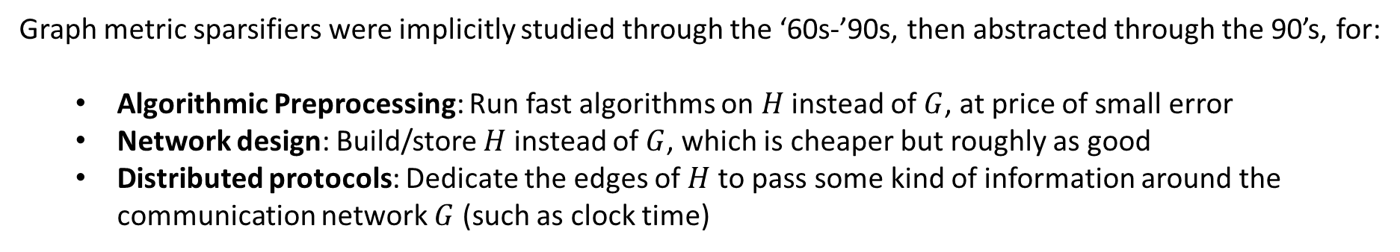


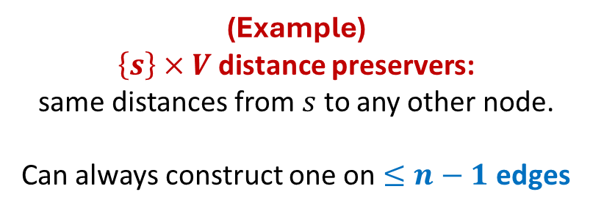
In the area of graph metric sparsification, the goal is to prove theorems of the form:
For every graph $G$, there is a graph $H$ that “approximately” preserves certain distance/reachability information of $G$, and also $|E\left(H\right)|$ is guaranteed to be “small.”
s
(Example)
$\left\{s\right\}×V$ distance preservers:
same distances from $s$ to any other node.
Can always construct one on $≤n−1$ edges
s
$$G$$
$$H$$
Graph metric sparsifiers were implicitly studied through the ‘60s-’90s, then abstracted through the 90’s, for:
Algorithmic Preprocessing: Run fast algorithms on $H$ instead of $G$, at price of small error
Network design: Build/store $H$ instead of $G$, which is cheaper but roughly as good
Distributed protocols: Dedicate the edges of $H$ to pass some kind of information around the communication network $G$ (such as clock time)

Slide 3
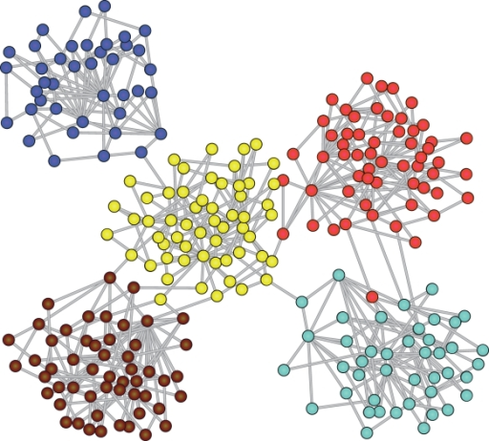
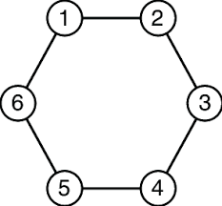

There are two families of techniques used in modern research on graph metric sparsification:
Graph clustering and decomposition methods
Forbidden structure methods
Advantage in fast construction algorithms
Advantage in ties to external areas
Proofs connect to metric theory
Advantage in proving quantitative bounds
Advantage in simplicity
Proofs connect to extremal combinatorics
This talk will be a survey* of this method

Slide 4
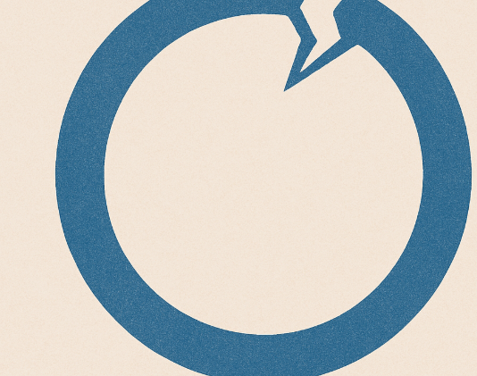
Part 1: Forbidden Cycles

Slide 5
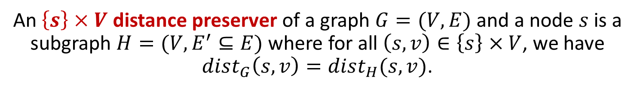


An $\left\{s\right\}×V$ distance preserver of a graph $G=(V,E)$ and a node $s$is a subgraph $H=(V,E^{′}⊆E)$ where for all $\left(s,v\right)∈\left\{s\right\}×V$, we have $dist_{G}\left(s,v\right)=dist_{H}(s,v)$.
s
s
$$G$$
$$H$$
Theorem: (folklore)
For every $n$-node graph $G$ and node $s$, there is an $\left\{s\right\}×V$ distance preserver $H$ on $\left|E\left(H\right)\right|≤n−1$ edges.

Slide 6

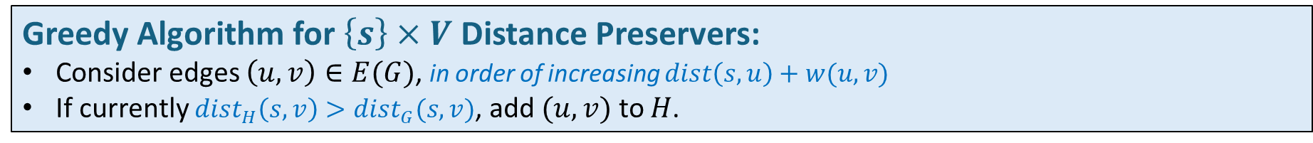
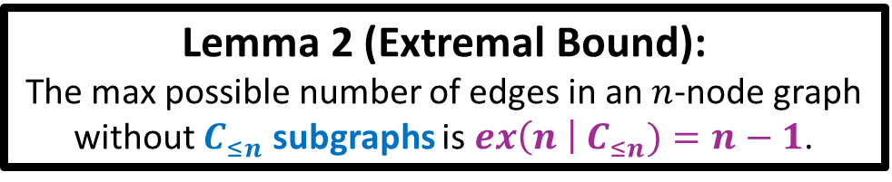
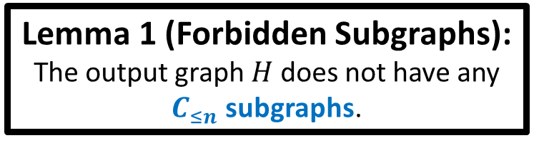

Greedy Algorithm for $\left\{s\right\}×V$ Distance Preservers:
Consider edges $\left(u,v\right)∈E(G)$, in order of increasing $dist\left(s,u\right)+w(u,v)$
If currently $dist_{H}\left(s,v\right)>dist_{G}(s,v)$, add $(u,v)$ to $H$.
s
s
$$G$$
$$H$$
Lemma 1 (Forbidden Subgraphs):
The output graph $H$ does not have any $C_{≤n}$ subgraphs.
Lemma 2 (Extremal Bound):
The max possible number of edges in an $n$-node graph without $C_{≤n}$ subgraphs is $ex\left(n \right| C_{≤n})=n−1$.

Slide 7


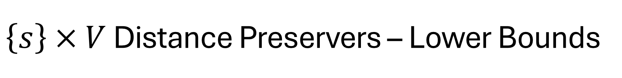
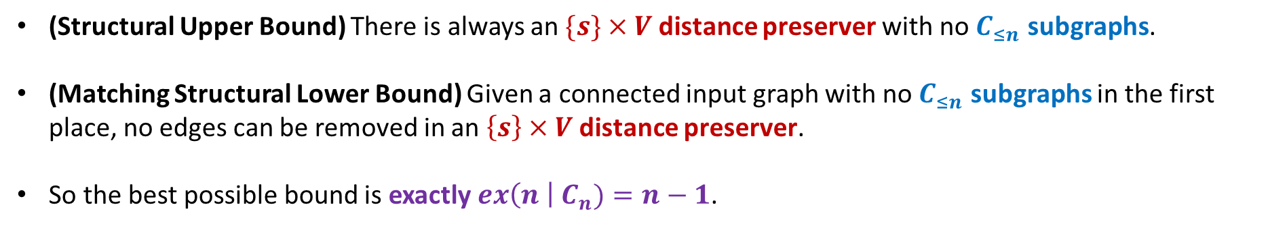
$\left\{s\right\}×V$ Distance Preservers – Lower Bounds
s
s
$$G$$
$$H$$
(Structural Upper Bound) There is always an $\{s\}×V$ distance preserver with no $C_{≤n}$ subgraphs.
(Matching Structural Lower Bound) Given a connected input graph with no $C_{≤n}$ subgraphs in the first place, no edges can be removed in an $\left\{s\right\}×V$ distance preserver.
So the best possible bound is exactly $ex\left(n \right| C_{n})=n−1$.

Slide 8
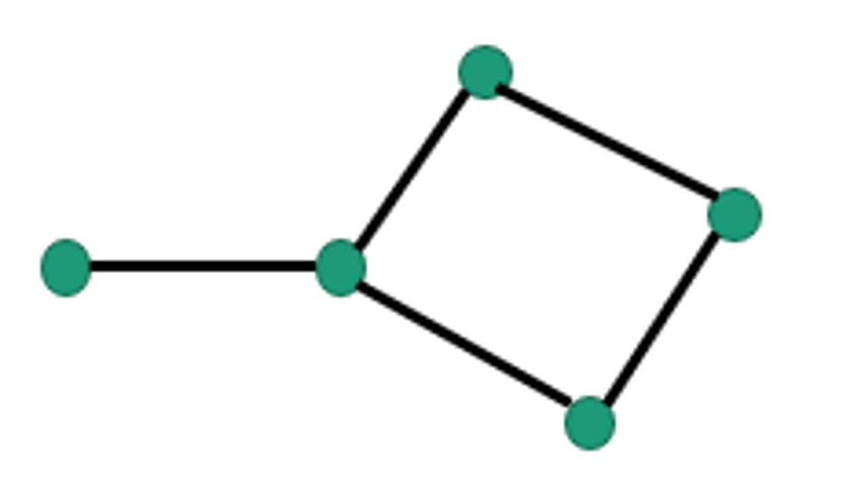
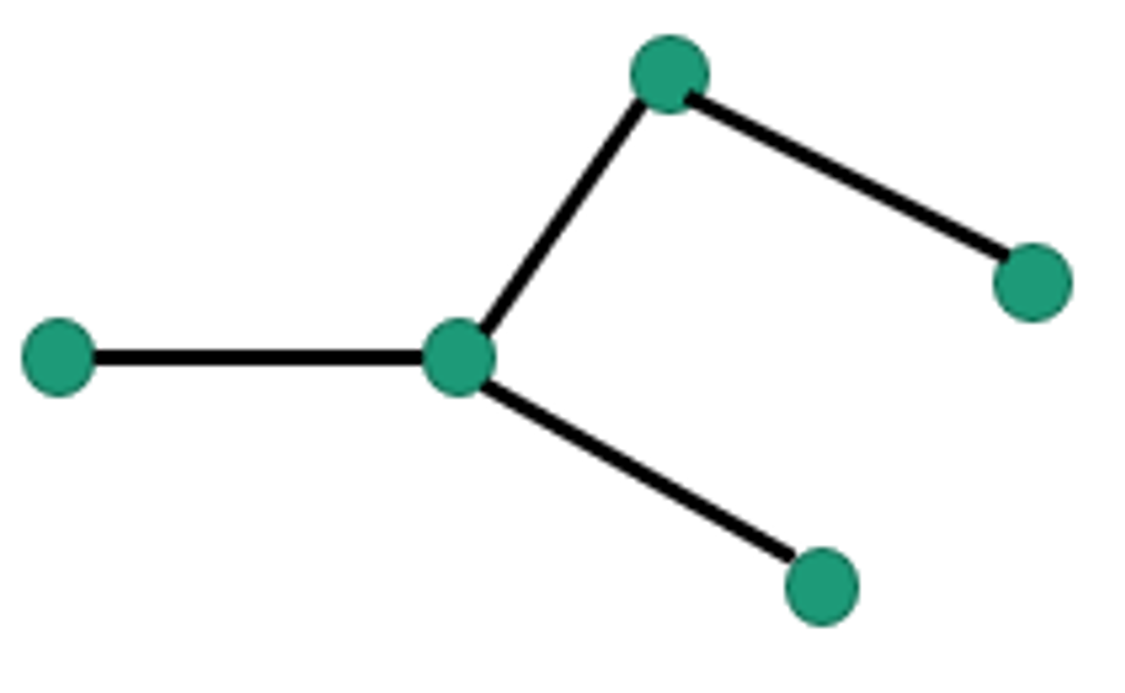
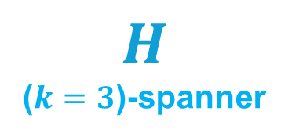
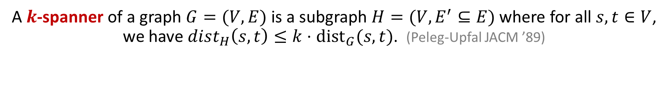

A $k$-spanner of a graph $G=(V,E)$ is a subgraph $H=(V,E^{′}⊆E)$ where for all $s,t∈V$, we have $dist_{H}\left(s,t\right)≤k⋅{dist}_{G}(s,t)$. (Peleg-Upfal JACM ’89)
$$H$$
($k=3$)-spanner
$$G$$
Theorem: (Althöfer, Das, Dobkin, Joseph, Soares ’93)
For every $n$-node graph $G$ and positive integer $k$, there is a $(2k−1)$-spanner $H$ on $\left|E\left(H\right)\right|≤O\left(n^{1+1/k}\right)$ edges.

Slide 9
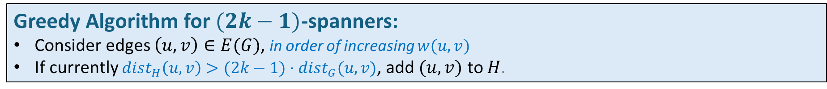

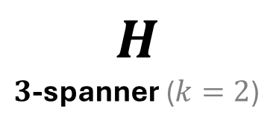
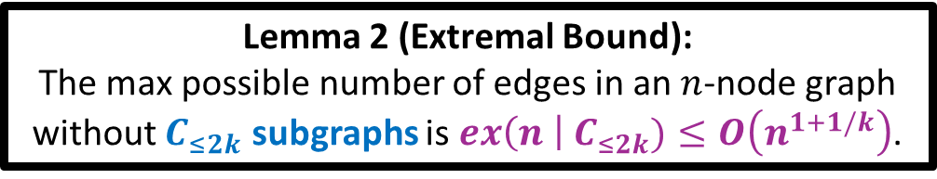
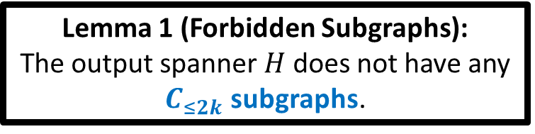
Greedy Algorithm for $(2k−1)$-spanners:
Consider edges $\left(u,v\right)∈E(G)$, in order of increasing $w(u,v)$
If currently $dist_{H}\left(u,v\right)>(2k−1)⋅dist_{G}(u,v)$, add $(u,v)$ to $H$.
$$G$$
$$H$$
$3$-spanner ($k=2$)
Lemma 1 (Forbidden Subgraphs):
The output spanner $H$ does not have any $C_{≤2k}$ subgraphs.
Lemma 2 (Extremal Bound):
The max possible number of edges in an $n$-node graph without $C_{≤2k}$ subgraphs is $ex\left(n \right| C_{≤2k})≤O\left(n^{1+1/k}\right)$.

Slide 10

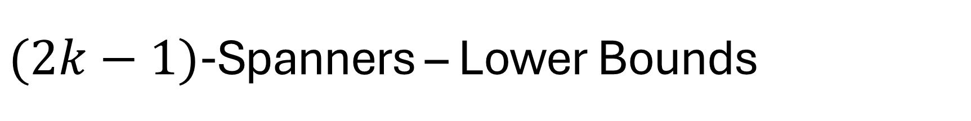
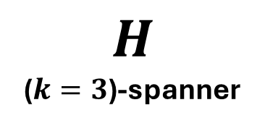
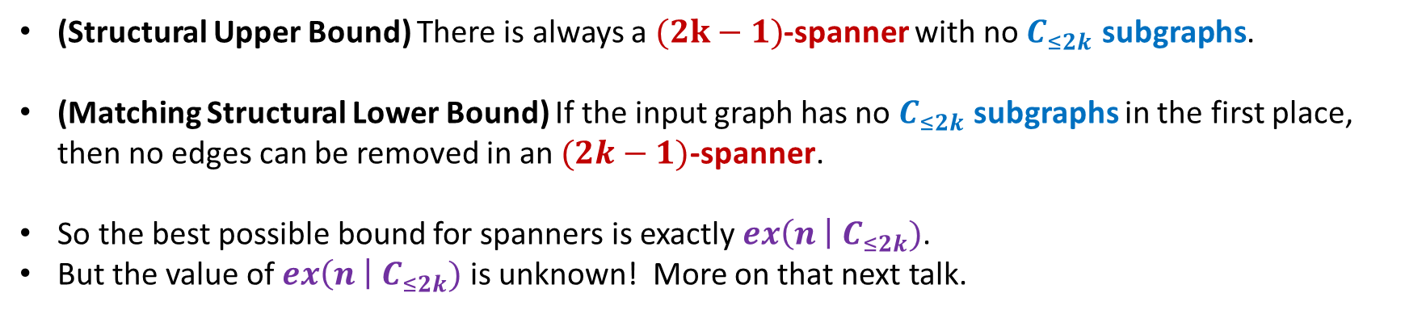
$(2k−1)$-Spanners – Lower Bounds
$$H$$
($k=3$)-spanner
$$G$$
(Structural Upper Bound) There is always a $(2k−1)$-spanner with no $C_{≤2k}$ subgraphs.
(Matching Structural Lower Bound) If the input graph has no $C_{≤2k}$ subgraphs in the first place, then no edges can be removed in an $(2k−1)$-spanner.
So the best possible bound for spanners is exactly $ex\left(n \right| C_{≤2k})$.
But the value of $ex\left(n \right| C_{≤2k})$ is unknown! More on that next talk.

Slide 11

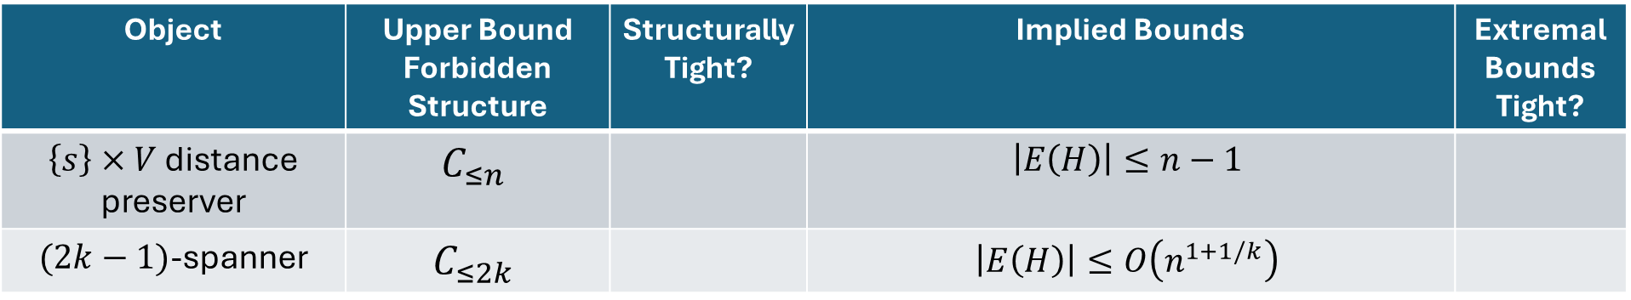
The Story So Far
Object | Upper Bound Forbidden Structure | Structurally Tight? | Implied Bounds | Extremal Bounds Tight?
$\left\{s\right\}×V$ distance preserver | $$C_{≤n}$$ |  | $$\left|E\left(H\right)\right|≤n−1$$
$(2k−1)$-spanner | $$C_{≤2k}$$ |  | $$\left|E\left(H\right)\right|≤O\left(n^{1+1/k}\right)$$

Slide 12
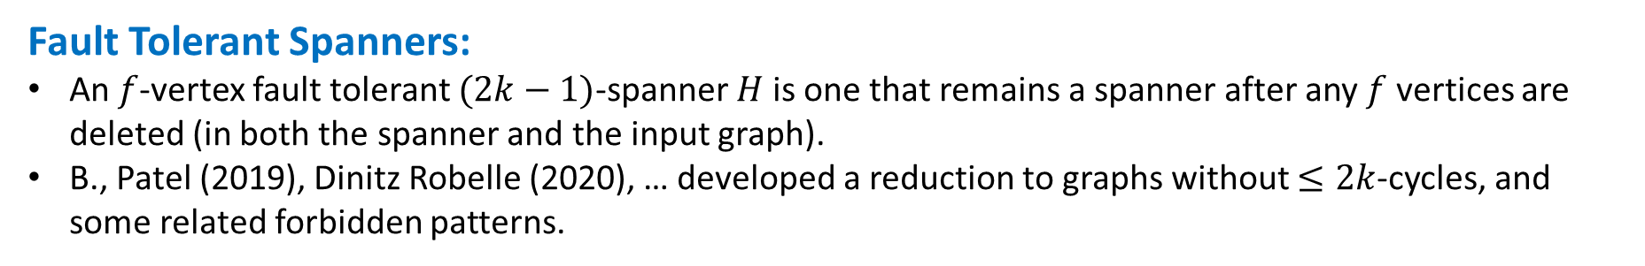
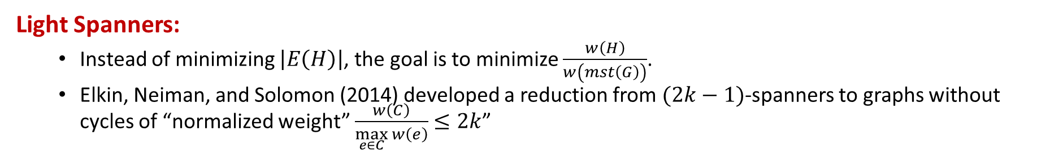

Some other uses of forbidden cycles
Light Spanners:
Instead of minimizing $\left|E\left(H\right)\right|$, the goal is to minimize $\frac{w\left(H\right)}{w\left(mst\left(G\right)\right)}$.
Elkin, Neiman, and Solomon (2014) developed a reduction from $(2k−1)$-spanners to graphs without cycles of “normalized weight” $\frac{w\left(C\right)}{\max_{e∈C}{w\left(e\right)}}$ $≤2k$”
2
1
3
Normalized Weight = $\frac{10}{4}$
4
Fault Tolerant Spanners:
An $f$-vertex fault tolerant $(2k−1)$-spanner $H$ is one that remains a spanner after any $f$ vertices are deleted (in both the spanner and the input graph).
B., Patel (2019), Dinitz Robelle (2020), … developed a reduction to graphs without $≤2k$-cycles, and some related forbidden patterns.

Slide 13

Part 2: Forbidden Structure in Incidence Graphs

Slide 14
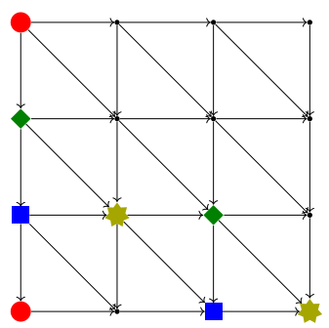
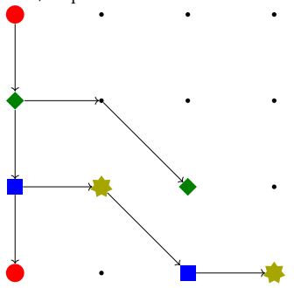
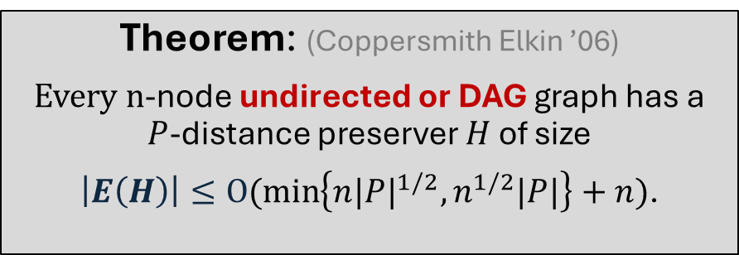



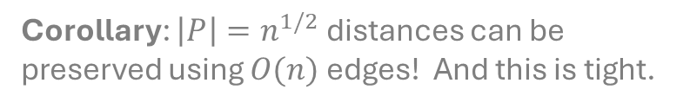
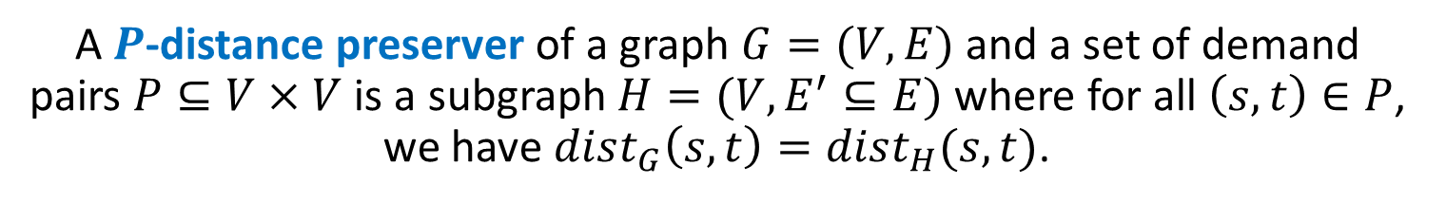
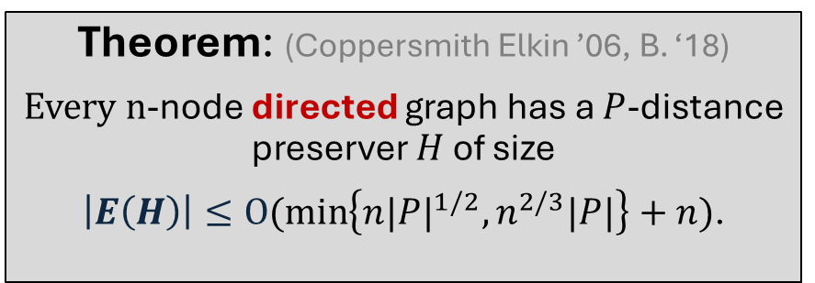
A $P$-distance preserver of a graph $G=(V,E)$ and a set of demand pairs $P⊆V×V$ is a subgraph $H=(V,E^{′}⊆E)$ where for all $\left(s,t\right)∈P$, we have $dist_{G}\left(s,t\right)=dist_{H}(s,t)$.
$$G$$
$$H$$
Theorem: (Coppersmith Elkin ’06)
Every $n$-node undirected or DAG graph has a $P$-distance preserver $H$ of size
$\left|E\left(H\right)\right|≤O(\min\left\{n{|P|}^{1/2},n^{1/2}|P|\right\}+n)$.
Theorem: (Coppersmith Elkin ’06, B. ‘18)
Every $n$-node directed graph has a $P$-distance preserver $H$ of size
$\left|E\left(H\right)\right|≤O(\min\left\{n{|P|}^{1/2},n^{2/3}|P|\right\}+n)$.
Corollary: $\left|P\right|=n^{1/2}$ distances can be preserved using $O(n)$ edges! And this is tight.
Corollary: $\left|P\right|=n^{1/3}$ distances can be preserved using $O(n)$ edges! Open: is this tight?

Slide 15
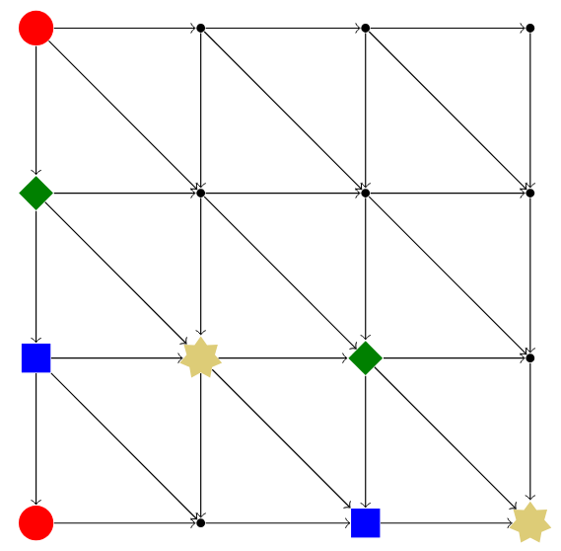
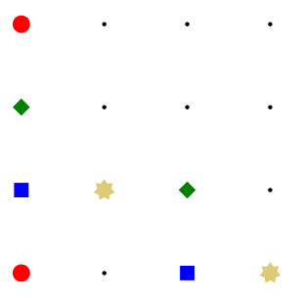
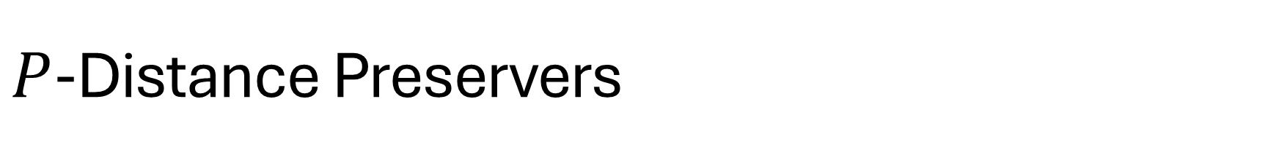


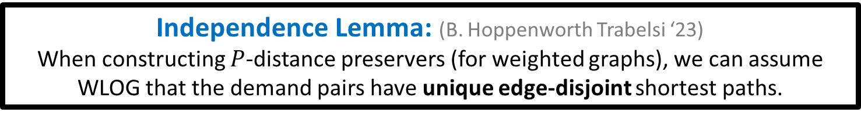

$P$-Distance Preservers
$$G$$
$$H$$
WLOG, the construction algorithm for $P$-distance preservers just adds one shortest path for each demand pair.
The only algorithmic decision making is how to break shortest path ties.
Inuitively, the instances requiring the largest preservers are those that do not provide opportunities for tiebreaking or shortest path overlap.
Independence Lemma: (B. Hoppenworth Trabelsi ‘23)
When constructing $P$-distance preservers (for weighted graphs), we can assume WLOG that the demand pairs have unique edge-disjoint shortest paths.

Slide 16
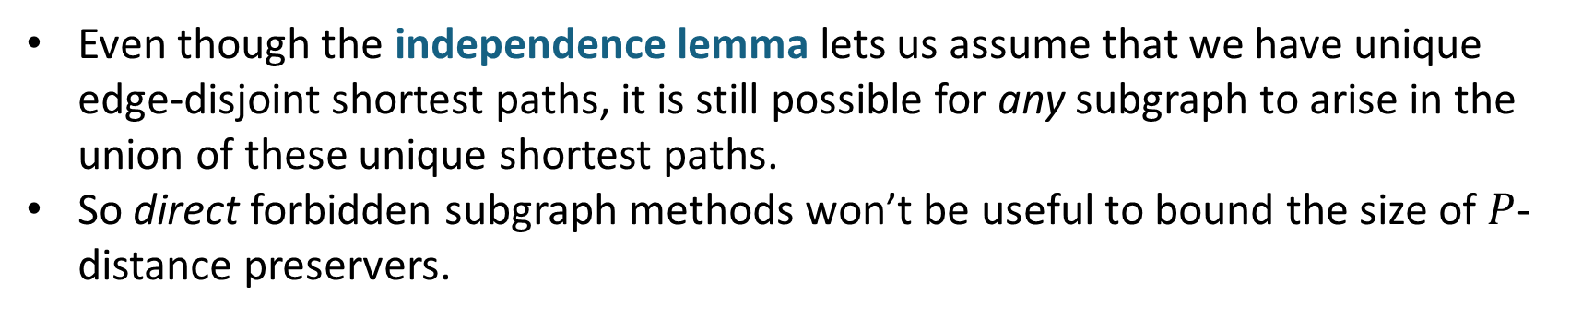
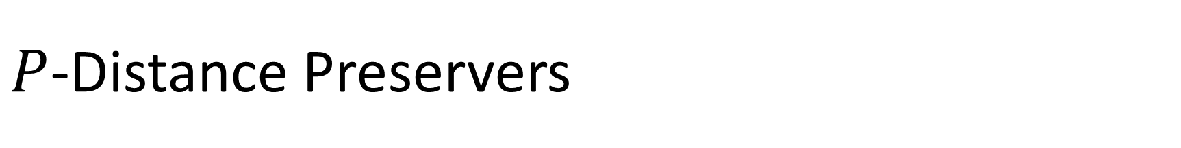
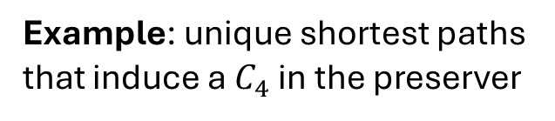
$P$-Distance Preservers
Even though the independence lemma lets us assume that we have unique edge-disjoint shortest paths, it is still possible for any subgraph to arise in the union of these unique shortest paths.
So direct forbidden subgraph methods won’t be useful to bound the size of $P$-distance preservers.
Example: unique shortest paths that induce a $C_{4}$ in the preserver

Slide 17
$P$-Distance Preservers
Even though the independence lemma lets us assume that we have unique edge-disjoint shortest paths, it is still possible for any subgraph to arise in the union of these unique shortest paths.
So direct forbidden subgraph methods won’t be useful to bound the size of $P$-distance preservers.
Example: unique shortest paths that induce a $C_{4}$ in the preserver

Slide 18
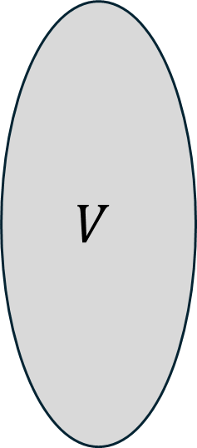
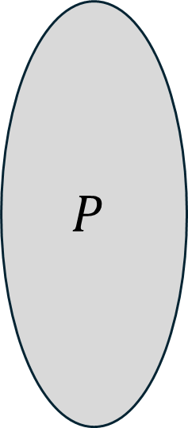
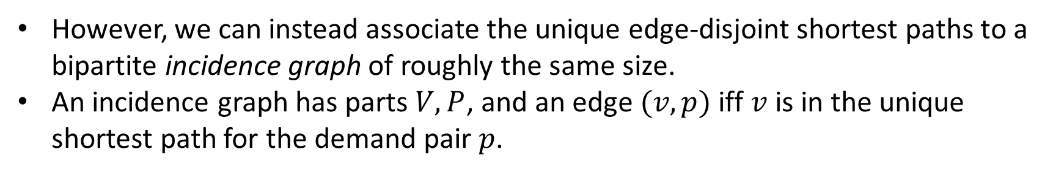
$P$-Distance Preservers
However, we can instead associate the unique edge-disjoint shortest paths to a bipartite incidence graph of roughly the same size.
An incidence graph has parts $V,P$, and an edge $(v,p)$ iff $v$ is in the unique shortest path for the demand pair $p$.
$$P$$
$$V$$
etc

Slide 19

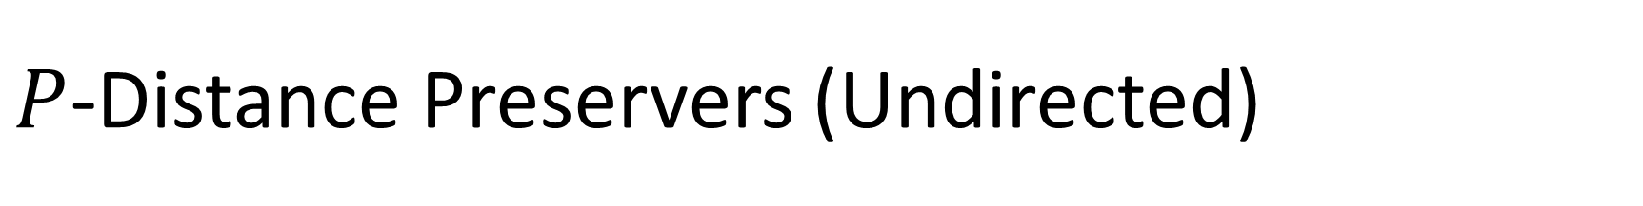

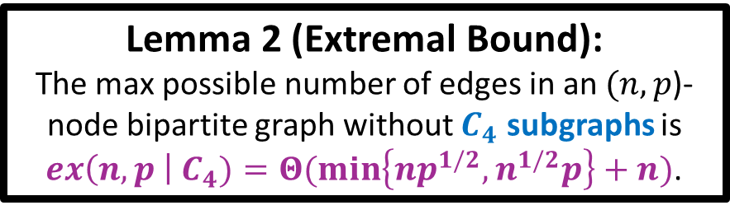
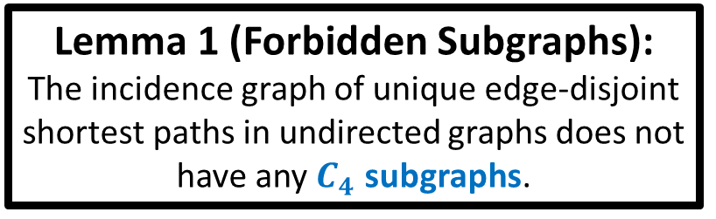

$P$-Distance Preservers (Undirected)
Independence Lemma: Two forbidden patterns in unique edge-disjoint undirected paths
Incidence Graph:
$$V$$
$$P$$
Forbidden
(edge-disjoint)
Forbidden
(unique shortest paths must use consistent subpaths)
$C_{4}$s Forbidden
Lemma 1 (Forbidden Subgraphs):
The incidence graph of unique edge-disjoint shortest paths in undirected graphs does not have any $C_{4}$ subgraphs.
Lemma 2 (Extremal Bound):
The max possible number of edges in an $(n,p$)-node bipartite graph without $C_{4}$ subgraphs is $ex\left(n,p \right| C_{4})=Θ(\min\left\{np^{1/2},n^{1/2}p\right\}+n)$.

Slide 20


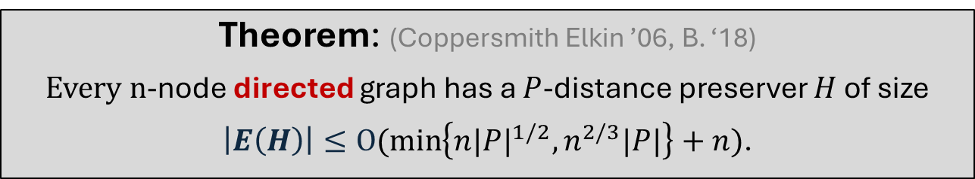

Theorem: (Coppersmith Elkin ’06, B. ‘18)
Every $n$-node directed graph has a $P$-distance preserver $H$ of size
$\left|E\left(H\right)\right|≤O(\min\left\{n{|P|}^{1/2},n^{2/3}|P|\right\}+n)$.
Independence Lemma: we may assume unique edge-disjoint shortest paths in the input graph.
However, the same proof does not work in the directed setting. Why not?
Incidence Graph
$$V$$
$$P$$
Allowed in unique edge-disjoint directed shortest paths
$C_{4}$s allowed!

Slide 21
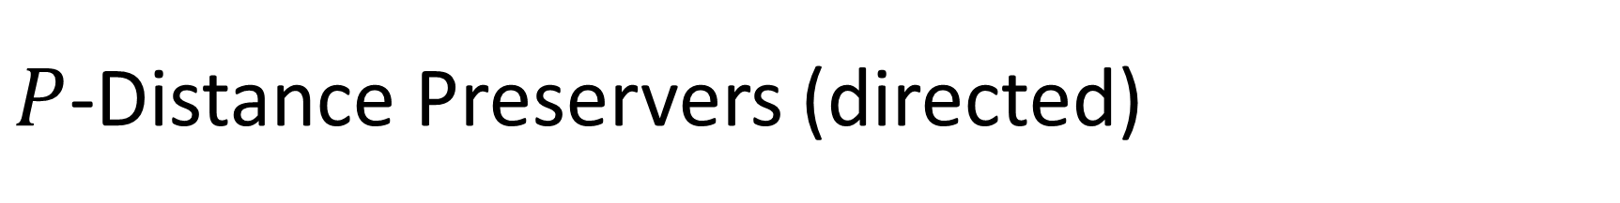
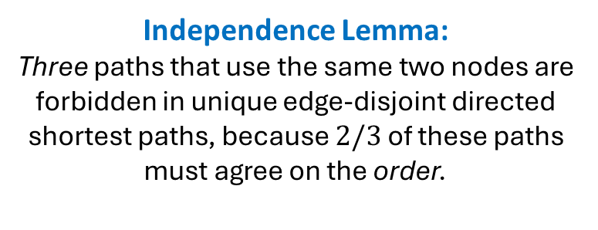



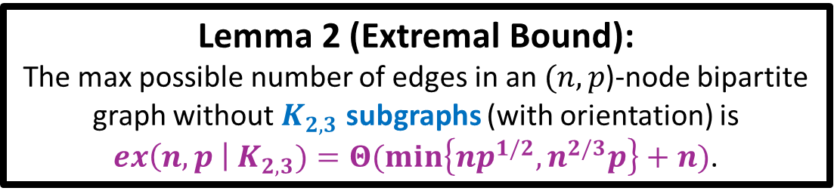
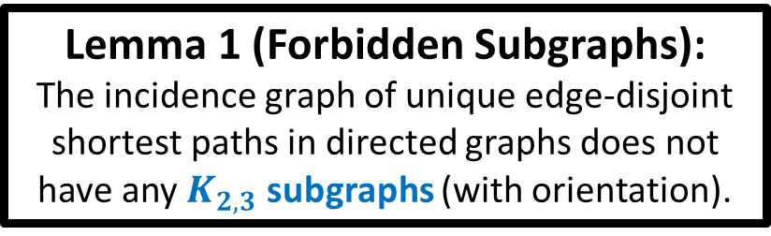
$P$-Distance Preservers (directed)
Incidence Graph
Independence Lemma:
Three paths that use the same two nodes are forbidden in unique edge-disjoint directed shortest paths, because $2/3$ of these paths must agree on the order.
$$P$$
$$V$$
(oriented) $K_{2,3}$s forbidden
Lemma 1 (Forbidden Subgraphs):
The incidence graph of unique edge-disjoint shortest paths in directed graphs does not have any $K_{2,3}$ subgraphs (with orientation).
Lemma 2 (Extremal Bound):
The max possible number of edges in an $(n,p$)-node bipartite graph without $K_{2,3}$ subgraphs (with orientation) is $ex\left(n,p \right| K_{2,3})=Θ(\min\left\{np^{1/2},n^{2/3}p\right\}+n)$.

Slide 22
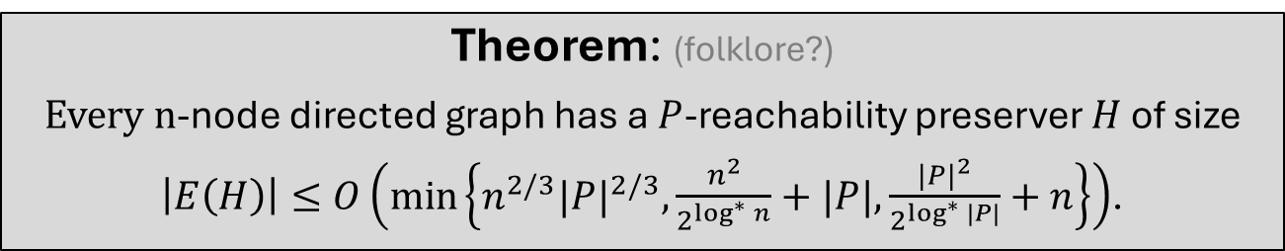



A $P$-reachability preserver of a graph $G=(V,E)$ and a set of demand pairs $P⊆V×V$ is a subgraph $H=(V,E^{′}⊆E)$ where for all $\left(s,t\right)∈P$, we have $dist_{G}\left(s,t\right)=dist_{H}(s,t)$.
$$G$$
$$H$$
Theorem: (folklore?)
Every $n$-node directed graph has a $P$-reachability preserver $H$ of size
$\left|E\left(H\right)\right|≤O\left(\min\left\{n^{2/3}{|P|}^{2/3},\frac{n^{2}}{2^{\log^{∗}{n}}}+|P|,\frac{{|P|}^{2}}{2^{\log^{∗}{|P|}}}+n\right\}\right)$.
Corollary: $\left|P\right|=n^{1/2+o(1)}$ reachabilities can be preserved using $O(n)$ edges! Open: Is this tight?

Slide 23









$P$-Reachability Preservers
Independence Lemma: We may assume unique edge-disjoint paths. So:
Incidence Graph
$$V$$
$$P$$
Forbidden
(unique paths)
Forbidden
(unique paths)
Forbidden
(edge-disjoint)
$$C_{4}$$
forbidden
$$V$$
$$P$$
Forbidden
(unique paths)
Forbidden
(unique paths)
$$C_{6}$$
forbidden
Lemma 1 (Forbidden Subgraphs):
The incidence graph of unique edge-disjoint directed paths does not have any $C_{≤6}$ subgraphs.
Lemma 2 (Extremal Bound):
$$ex\left(n,p \right| C_{≤6})≤O\left(\min\left\{n^{2/3}{|P|}^{2/3},\frac{n^{2}}{2^{\log^{∗}{n}}}+|P|,\frac{{|P|}^{2}}{2^{\log^{∗}{|P|}}}+n\right\}\right)$$

Slide 24

The Story So Far
Object | Upper Bound Forbidden Structure | Structurally Tight? | Implied Bounds | Extremal Bounds Tight?
$\left\{s\right\}×V$ distance preserver | $$C_{≤n}$$ |  | $$\left|E\left(H\right)\right|≤n−1$$
$(2k−1)$-spanner | $$C_{≤2k}$$ |  | $$\left|E\left(H\right)\right|≤O\left(n^{1+1/k}\right)$$
Undirected $P$-Distance Preservers | $$C_{4}$$ |  | $$\left|E\left(H\right)\right|≤O(\min\left\{n{|P|}^{1/2},n^{1/2}|P|\right\}+n)$$
Directed $P$-Distance Preservers | $$K_{2,3}$$ |  | $$\left|E\left(H\right)\right|≤O(\min\left\{n{|P|}^{1/2},n^{2/3}|P|\right\}+n)$$
$P$-Reachability Preservers | $$C_{6}$$ |  | $$\left|E\left(H\right)\right|≈O\left(n^{2/3}{|P|}^{2/3}\right)$$

Slide 25

Some other uses of forbidden patterns in Incidence Graphs
Additive Spanners for unweighted graphs:
(Aingworth Chekuri Indyk Motwani 95): Every $n$-node graph has a $+2$ spanner on $O\left(n^{3/2}\right)$ edges
(Chechik 13): Every $n$-node graph has a spanner with $+4$ error on $\tilde{O}\left(n^{7/5}\right)$ edges
(Baswana Kavitha Mehlhorn Pettie 06): Every $n$-node graph has a spanner with $+6$ error on $O\left(n^{4/3}\right)$ edges
(Knudsen 14): re-proved the upper bounds using forbidden subgraphs in a certain layered incidence graph.
Distance preservers for unweighted graphs (B. Vassilevska Williams 2016, Hoppenworth Xu Xu 2024)

Slide 26

Part 3: Forbidden Structure in Path Systems

Slide 27




Path Systems
Using an incidence graph loses information about node order within paths.
A path system is a kind of hypergraph $S=(V,Π)$
$V=$ vertices, $Π=$ “paths” = nonempty sequences of distinct vertices
“size” = # edges in incidence graph = sum of # nodes in each path
“subsystem” = any system that can be obtained by repeatedly deleting paths, or nodes from the middle of paths.
Could be directed or undirected
d
$$⊆$$
Size = $3+3+3+3=12$
a
e

Slide 28







$P$-Reachability Preservers, Revisited
By the independence lemma, we may assume unique edge-disjoint paths among the demand pairs.
The system of these paths has these forbidden subsystems:
…
2-bridge $B_{2}$
3-bridge $B_{3}$
4-bridge $B_{4}$
Lemma 1 (Forbidden Subsystems):
The system of unique edge-disjoint paths in $n$-node directed graphs does not have any $B_{≤n}$ subsystems.
Lemma 2 (Extremal Bounds):
(B. Hoppenworth Trabelsi ‘23, B. Le ’25)
The maximum possible size of an $n$-node, $p$-path system with no bridge subsystems is
$$ex\left(n,p \right| B_{≤n})≤O(n^{3/4}p^{1/2}+n^{2−\sqrt{2}+o(1)}p^{1/\sqrt{2}}+n)$$
This bound is polynomially better than the one for $ex\left(n,p \right| C_{≤6})$.

Slide 29





$P$-Reachability Preservers, Revisited
$$G$$
$$H$$
Bridges $B_{k}$
(Structural Upper Bound) A system of unique edge-disjoint paths has no $B_{≤n}$ subsystems.
(Matching Structural Lower Bound) A path system with no $B_{≤n}$ subsystems in the first place implies that no edges can be removed from the associated $P$-reachability preserver instance.
So the best possible bound for reachability preservers is exactly $ex\left(n,p \right| B_{≤n})$.
But the asymptotic value of this function is unknown! More on that next talk.

Slide 30

The Story So Far
Object | Upper Bound Forbidden Structure | Structurally Tight? | Implied Bounds | Extremal Bounds Tight?
$\left\{s\right\}×V$ distance preserver | $$C_{≤n}$$ |  | $$\left|E\left(H\right)\right|≤n−1$$
$(2k−1)$-spanner | $$C_{≤2k}$$ |  | $$\left|E\left(H\right)\right|≤O\left(n^{1+1/k}\right)$$
Undirected $P$-Distance Preservers | $$C_{4}$$ |  | $$\left|E\left(H\right)\right|≤O(\min\left\{n{|P|}^{1/2},n^{1/2}|P|\right\}+n)$$
Directed $P$-Distance Preservers | $$K_{2,3}$$ |  | $$\left|E\left(H\right)\right|≤O(\min\left\{n{|P|}^{1/2},n^{2/3}|P|\right\}+n)$$
$P$-Reachability Preservers | $$B_{≤n}$$ (not $C_{6}$) |  | $$\left|E\left(H\right)\right|≈O\left(n^{3/4}{|P|}^{1/2}+n^{2−\sqrt{2}+o(1)}{|P|}^{1/\sqrt{2}}+n\right)$$

Slide 31





$P$-Distance Preservers - Directed, Revisited
Any system of unique edge-disjoint shortest paths in a directed graph has the following forbidden subsystem:
2-bridge $B_{2}$
Lemma 1 (Forbidden Subsystems):
The system of unique edge-disjoint shortest paths in $n$-node directed graphs does not have any $B_{2}$ subsystems.
Lemma 2 (Extremal Bounds):
(B. Hoppenworth Trabelsi ‘23)
The maximum possible size of an $n$-node, $p$-path system with no $B_{2}$ subsystem is
$$ex\left(n,p \right| B_{2})=Θ(\min\left\{np^{1/2},n^{2/3}p\right\}+n)\text{.}$$
Bad news: Although path systems give us a new forbidden pattern, it won’t be useful to improve on the previous incidence graph analysis using $ex\left(n,p \right| K_{2,3})$.

Slide 32




$P$-Distance Preservers - Undirected, Revisited
Any system of unique edge-disjoint shortest paths in an undirected graph has the following forbidden subsystem:
2-bridge $B_{2}$
Lemma 1 (Forbidden Subsystems):
The system of unique edge-disjoint shortest paths in $n$-node undirected graphs does not have any $B_{2}$ subsystems.
Lemma 2 (Extremal Bounds):
(B. Hoppenworth Trabelsi ‘23)
The maximum possible size of an $n$-node, $p$-path undirected system with no $B_{2}$ subsystem is
$$ex\left(n,p \right| B_{2})=Θ(\min\left\{np^{1/2},n^{1/2}p\right\}+n)\text{.}$$
More Bad News: Although path systems give us a new forbidden pattern, it won’t be useful to improve on the previous incidence graph analysis using $ex\left(n,p \right| C_{4})$.
Are there any additional forbidden subsystems in unique edge-disjoint directed paths, besides $B_{2}$?

Slide 33





$P$-Distance Preservers, Revisited
Theorem: (B. 19)
The following path system cannot be realized as unique shortest paths, under any edge weights (despite not containing $B_{2}$ as a subsystem)
$$B_{2}$$
Proof: Suppose for contradiction that there are weights that induce these four paths as unique shortest paths.
$$ac+ce<ad+de$$
$$ad+df<ac+cf$$
$$bc+cf<bd+df$$
$$bd+de<bc+ce$$
$$0<0$$

Slide 34


$P$-Distance Preservers, Revisited
New forbidden subsystem in directed unique edge-disjoint shortest paths. Where do we find more?
This path system “embeds” into a 2-colored octahedron
The nodes on each path appear in clockwise order around its corresponding face
Each gray face has only one “endpoint edge” $\{ae,af,be,bf\}$
Theorem: (B. 19)
Any path system that “embeds” into a 2-colored polyhedron (including degenerate and toroidal cases) cannot appear as a subsystem of the unique shortest paths of any directed weighted graph. This list of forbidden subsystems is complete.

Slide 35





$P$-Distance Preservers, Revisited
Three more examples of forbidden subsystems in unique edge-disjoint shortest paths

Slide 36

$P$-Distance Preservers, Undirected, Revisited
One of the requirements for this path system to “embed” in an octahedron is that the paths go clockwise around each face.
This requirement no longer makes sense for undirected path systems, and so is omitted from the characterization. As a result …

Slide 37


$P$-Distance Preservers, Revisited
In the undirected setting, subsystems are also forbidden that embed into non-orientable polyhedra.

Slide 38



$P$-Distance Preservers, Revisited
Let $Q_{und}, Q_{dir}$ be the set of undirected, directed path systems that embed into polyhedra
Theorem: (B. ‘19)
Every $n$-node undirected graph has a $P$-distance preserver $H$ of size
$\left|E\left(H\right)\right|≤ex\left(n \right| B_{2},Q_{und})$.
Theorem: (B. ‘19)
Every $n$-node directed graph has a $P$-distance preserver $H$ of size
$\left|E\left(H\right)\right|≤ex\left(n \right| B_{2},Q_{dir})$.

Slide 39

The State of the Art Upper Bounds
Object | Upper Bound Forbidden Structure | Structurally Tight? | Implied Bounds | Extremal Bounds Tight?
$\left\{s\right\}×V$ distance preserver | $$C_{≤n}$$ |  | $$\left|E\left(H\right)\right|≤n−1$$
$(2k−1)$-spanner | $$C_{≤2k}$$ |  | $$\left|E\left(H\right)\right|≤O\left(n^{1+1/k}\right)$$
Undirected $P$-Distance Preservers | $$\left\{B_{2}\right\}∪Q_{und}$$ (not $C_{4}$) |  | $$\left|E\left(H\right)\right|≤O(\min\left\{n{|P|}^{1/2},n^{1/2}|P|\right\}+n)$$
Directed $P$-Distance Preservers | $$\left\{B_{2}\right\}∪Q_{dir}$$ (not $K_{2,3}$) |  | $$\left|E\left(H\right)\right|≤O(\min\left\{n{|P|}^{1/2},n^{2/3}|P|\right\}+n)$$
$P$-Reachability Preservers | $$B_{≤n}$$ |  | $$\left|E\left(H\right)\right|≈O\left(n^{3/4}{|P|}^{1/2}+n^{2−\sqrt{2}+o(1)}{|P|}^{1/\sqrt{2}}+n\right)$$
Structural side is complete* for these objects! We mostly need new ideas on the side of extremal bounds.

Slide 40



Tardos’ Ordered Matrix Function
Gábor Tardos (2018) introduced and studied an extremal function about ordered matrices avoiding certain submatrices. It’s equivalent to $ex\left(n, p \right| β)$, where $β$ is the set of all path systems in which every path is the river of some bridge.
(Example) System where every path is the river of a 3-bridge
Theorem: (Tardos 18)
$$Ω\left(n^{2/3}p^{2/3}+n+p\right)≤ex\left(n, p \right| β)≤\left|E\left(H\right)\right|≤O(\min\left\{n{|P|}^{1/2},n^{1/2}|P|\right\}+n)$$
Conjectured that the lower bound is tight.
Theorem: (B. Hoppenworth Trabelsi 23)
Every system avoiding $β$ can be realized as unique edge-disjoint shortest paths. Open: could we also reduce upper bounds to this object?

Slide 41

Other uses of forbidden patterns in Path Systems
Shortcut Sets
The goal is to add a small budget of extra edges to a graph, to reduce its diameter (largest shortest path distance among reachable pairs).
Upper and lower bounds have recently been reduced to related forbidden patterns in path systems (B. Hoppenworth 23, Vassilevska Williams Xu Xu 25, Bals et al 25)
The Directed Flow-Cut Gap
Min-Cut/Max Flow are equal for a single demand pair, but generally different when there are multiple demand pairs.
The maximum possible gap between these for directed graphs is a significant open problem, which can also be approached using forbidden subsystems in path systems (Chuzhoy Khanna 07, B. Samborska 26?)
The red edges reduce diameter to 5

Slide 42

Incompressibility Theorems

Slide 43
Incompressibility Theorems
All of the graph sparsifiers discussed here have an associated incompressibility theorem.
An incompressibility theorem is a result that says something like:
Consider a data structure that “does the same task” as the graph sparsifier
Theorem: There is no general way to construct a data structure that is much smaller-space than the sparsifier would be.

Slide 44






(Example) Distance Oracles
Input: Graph $G$, stretch $k$
Output: Data structure that, on $query(s,t)$, reports a $⋅k$ approximate $s→t$ shortest path.
Stretch $⋅3$
(Stanford, Berkeley)?
Preprocessing
$⋅3$ approx
(UCLA, UC San Diego)?
Input graph + stretch factor
Small-space data structure

Slide 45






Incompressibility Theorems
Incompressibility Theorem: [Matousek ‘97, Thorup-Zwick ’06, …]
One way to construct a stretch $k$ distance oracle for a graph $G$ is to construct a sparse $k$-spanner $H$, and then answer a query $(s, t)$ by returning a shortest path in $H$.
This strategy is near-optimal in terms of space.
Query $(s, t)$
Input graph $G$
Spanner $H$
So the Turán method also controls the size usage of approximate, low-space data structures

Slide 46

To be continued after the break
Summary
A common way to construct graph metric sparsifiers is:
Use a simple greedy algorithm that is easy to prove correct
Observe some forbidden pattern(s) in the resulting graph, or incidence graph, or path system
Do extremal combinatorics to bound the maximum possible size of a system with forbidden patterns.

